Slide 1


Dynamic Memory Allocation
Self-referential Structure
DIUBLC

Slide 2
Dynamic Memory Allocation (1/4)
Allocate memory dynamically i.e. when the program runs in the memory
Powerful concept of programming dynamic structure
Memory is allocated form the hep location of the memory
Dynamic memory allocation is the heart of the data structure
@DIUBLC

Slide 3
Dynamic Memory Allocation(2/4)
How to allocate memory dynamically?
  Use the library function malloc() form the library stdlib.h
  Syntax: int *p; p = (int*) malloc(n * sizeof(int));
  First declare a pointer of the desired type
    In this case int *p; (pointer of type int)
  Second call the function malloc()
    the first part (int*) is called type cast (used to convert the character pointer returned by malloc to desired type and in this cae int)
    n is the number of location
    sizeof is a macro function to get the size of data type in byte
    sizeof(int) means get byte for int data type
@DIUBLC

Slide 4
Dynamic Memory Allocation (3/4)
Some example:
  int *p;
  p = (int *) malloc(4 * sizeof(int) );
  [p is a pointer pointing to an array now]
  0 1 2 3
  p[0] = 5; p[1] = 7;
5 | 7
@DIUBLC

Slide 5
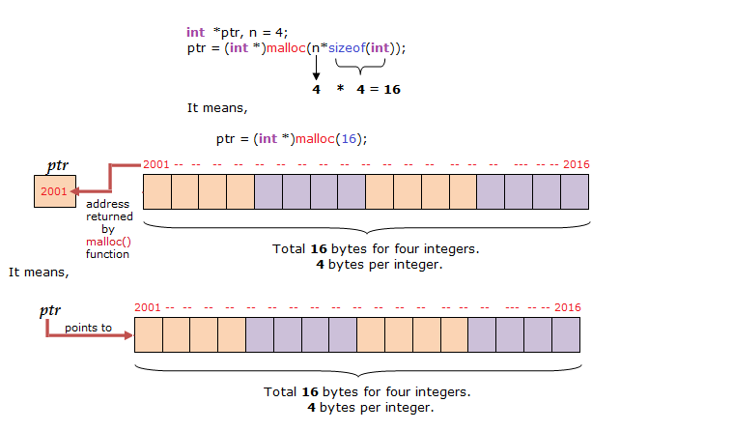
Dynamic Memory Allocation (4/4)
@DIUBLC

Slide 6
Self-Referential Structure (1/4)
A structure (struct in c) whose one member is a pointer of its own type
  e.g
    struct Point{
    int data;
    struct Point *pt;}
    pt is a pointer member of the type struct Point
    pt is a pointer member of the same type
    It is called a self-referential structure as it refer to itself
data pt
(how it looks like)
@DIUBLC

Slide 7
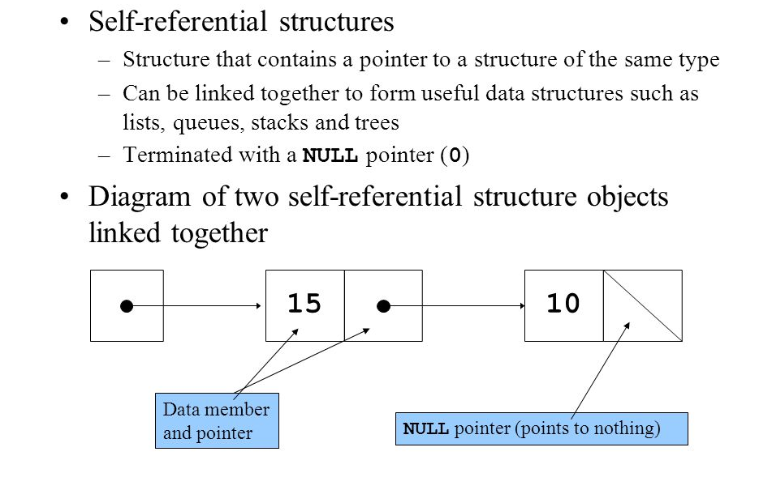
Self-Referential Structure (2/4)
@DIUBLC

Slide 8
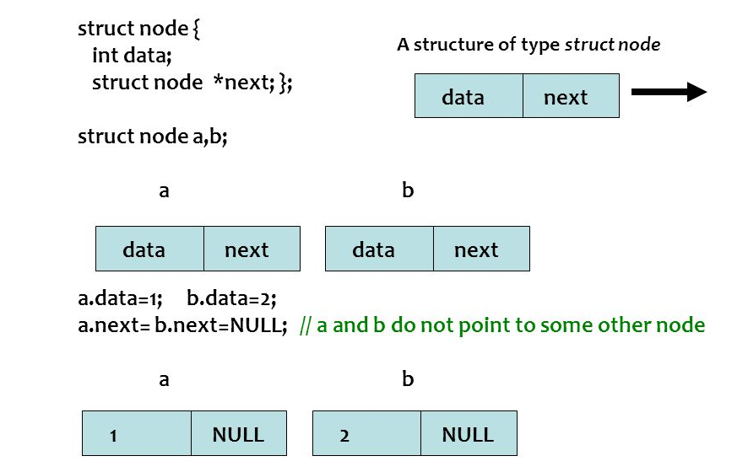
Self-Referential Structure (3/4)
@DIUBLC

Slide 9
Self-Referential Structure (4/4)
  struct Point{
  int data;
  struct Point *pt; };
  typedef struct Point point;
  …
  point *head;
  head = (point*) malloc(sizeof(point));
  head->data = 5;
  head->pt = (point*) malloc(sizeof(point));
  head->pt->data=7; head->pt->pt=NULL;
head
5
7
null
@DIUBLC

Slide 10
Summary
Dynamic memory allocation is the key to create dynamic allocation
Self-referential structure plays the most vital role in dynamic data structure
@DIUBLC

